Slide 1
Configuring Print, Document Services, Servers for Remote Management

Slide 2
Objective
Configuring Print & Document Services
Deploying a print server
Sharing a Printer
Managing Documents & Printer
Using the Print and Document Services Role
Configuring Servers for Remote Management
Using Server Manager for Remote Management
Using Remote Server Administration Tools

Slide 3
Configuring Print & Document Services
Deploying a print server
Sharing a Printer
Managing Documents & Printer
Using the Print and Document Services Role

Slide 4
Deploying a print server
Understanding the Windows Print Architecture
Understanding Windows Printing
Windows Printing Flexibility

Slide 5
Understanding the Windows Print Architecture
It is important to understand the terms Microsoft uses when referring to the components of the network printing architecture.
Printing in Microsoft Windows typically involves the following four components:
Print device
Printer
Print server
Printer driver

Slide 6
Understanding the Windows Print Architecture (Contd.,)
Print device A print device is the actual hardware that produces hard-copy documents on paper or other print media.
Windows Server 2012 R2 supports both local print devices, which are attached directly to computer ports, and network interface print devices, which are connected to the network either directly or through another computer.

Slide 7
Understanding the Windows Print Architecture (Contd.,)
Printer In Windows, a printer is the software interface through which a computer communicates with a print device.
Windows Server 2012 R2 supports numerous physical interfaces, including Universal Serial Bus (USB), IEEE 1394 (FireWire), parallel (LPT-Line Print terminal), serial (COM), Infrared Data Access (IrDA), Bluetooth ports, and network printing services such as LPR, Internet Printing Protocol (IPP), and standard TCP/IP ports.

Slide 8
Understanding the Windows Print Architecture (Contd.,)
Print server A print server is a computer (or standalone device) that receives print jobs from clients and sends them to print devices that are either attached locally or connected to the network.
Printer driver A printer driver is a device driver that converts the print jobs generated by applications into an appropriate string of commands for a specific print device.
Printer drivers are designed for a specific print device and provide applications with access to all the print device’s features.
Notes:
PRINTING NOMENCLATURE
“Printer” and “print device” are the most commonly misused terms in the Windows printing
vocabulary. Obviously, many sources use “printer” to refer to the printing hardware.
However, in Windows, printer and print device are not equivalent. For example, you can
add a printer to a Windows Server 2012 R2 computer without a physical print device being
present. The computer can then host the printer, print server, and printer driver. These
three components enable the computer to process the print jobs and store them in a print
queue until the print device is available.

Slide 9
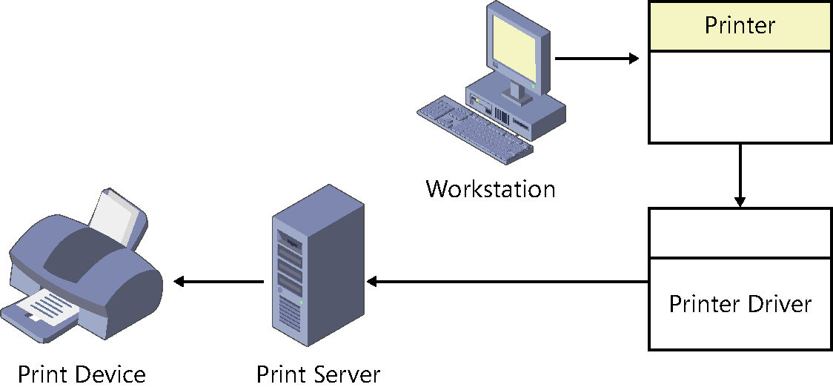
Understanding Windows Printing
These four components work together to process the print jobs produced by Windows applications and turn them into hard-copy documents, as shown in Figure.
Fig: The Windows print architecture

Slide 10
Understanding Windows Printing (Contd.,)
Before you can print documents in Windows, you must install at least one printer. To install a printer in Windows, you must do the following:
Select the print device’s specific manufacturer and model.
Specify the port (or other interface) the computer will use to access the print device.
Supply a printer driver created specifically for that print device.
When you print a document in an application, you select the printer that will be the destination for the print job.

Slide 11
Windows printing flexibility
The flexibility of the Windows print architecture is manifested in the different ways you can deploy the four printing components.
A single computer can perform all the roles (except for the print device, of course) or you can distribute those roles across the network.
Direct printing
Locally attached printer sharing
Network-attached printing
Network-attached printer sharing
You can scale these configurations up to accommodate a network of virtually any size.

Slide 12

DIRECT PRINTING
The simplest print architecture consists of one print device connected to one computer, also known as a locally attached print device, as shown in Figure.
When you connect a print device directly to a Windows Server 2012 R2 computer and print from an application running on that system, the computer supplies the printer, printer driver, and print server functions.
Fig: A locally attached print device

Slide 13
LOCALLY ATTACHED PRINTER SHARING
In addition to printing from an application running on that computer, you can also share the printer (and the print device) with other users on the same network.
In this arrangement, the computer with the locally attached print device functions as a print server.
Figure shows the other computers on the network, which are known as the print clients.

Slide 14
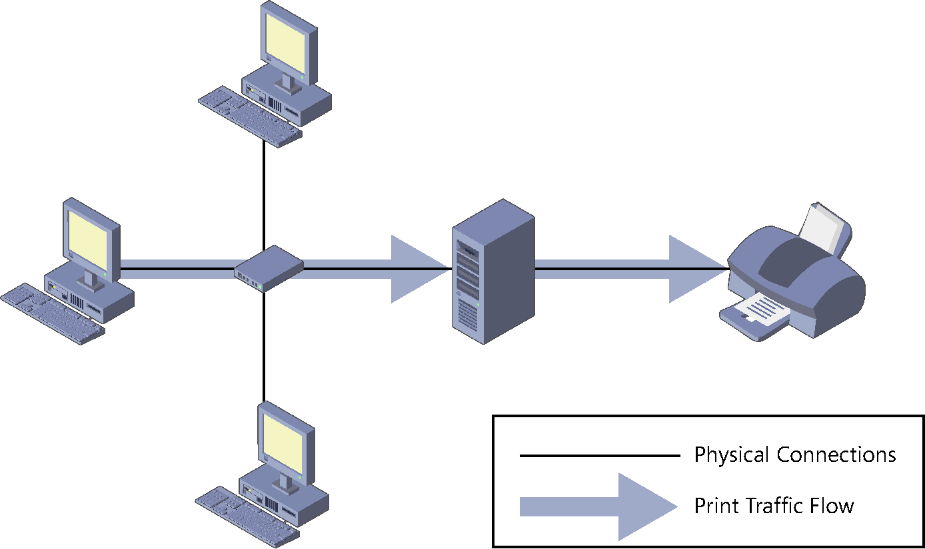
LOCALLY ATTACHED PRINTER SHARING (Contd.,)
Fig: Sharing a locally attached printer

Slide 15
LOCALLY ATTACHED PRINTER SHARING (Contd.,)
In the default Windows Server 2012 R2 printer-sharing configuration, each client uses its own printer and printer driver.
The main advantage of this printing arrangement is that multiple users, located anywhere on the network, can send jobs to a single print device connected to a computer functioning as a print server.
The downside is that processing the print jobs for many users can impose a significant burden on the print server.

Slide 16
NETWORK-ATTACHED PRINTING
The printing solutions discussed thus far involve print devices connected directly to a computer using a USB or other port.
Print devices do not necessarily have to be attached to computers, however.
You can connect a print device directly to the network instead.
Many print device models are equipped with network interface adapters, enabling you to attach a standard network cable.
Print devices so equipped have their own IP addresses and typically have an embedded web-based configuration interface.

Slide 17
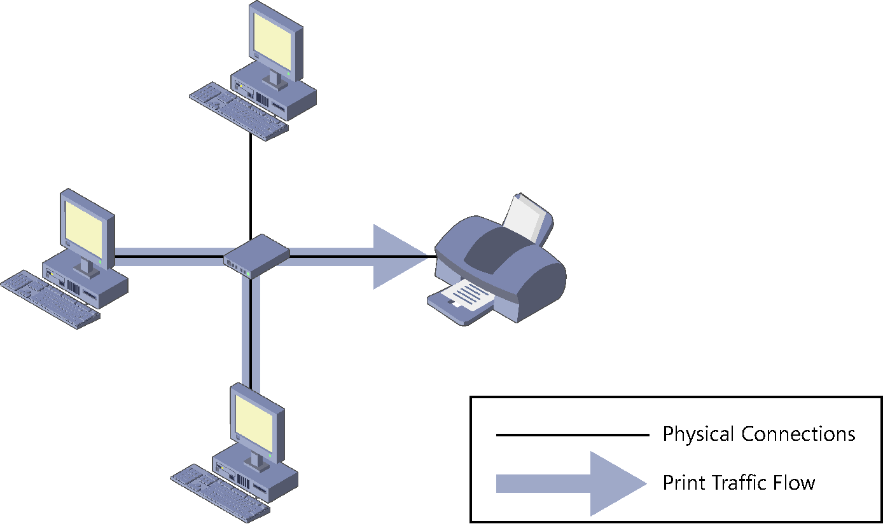
NETWORK-ATTACHED PRINTING (Contd.,)
Fig: A network-attached print device with multiple print servers

Slide 18
NETWORK-ATTACHED PRINTING (Contd.,)
Even individual end users with no administrative assistance will find this arrangement simple to set up. However, the disadvantages are many, including the following:
Users examining the print queue see only their own jobs.
Users are oblivious of the other users accessing the print device. They have no way of knowing what other jobs have been sent to the print device or how long it will be until the print device completes their jobs.

Slide 19
NETWORK-ATTACHED PRINTING (Contd.,)
Administrators have no way of centrally managing the print queue because each client has its own print queue.
Administrators cannot implement advanced printing features, such as printer pools or remote administration.
Error messages appear only on the computer that originated the job that the print device is currently processing.
All print job processing is performed by the client computer rather than being partially offloaded to an external print server.

Slide 20
NETWORK-ATTACHED PRINTER SHARING
The other option for network-attached printing is to designate one computer as a print server and use it to service all the print clients on the network.
To do this, you install a printer on one computer (which becomes the print server) and configure it to access the print device directly through a TCP port.
As you can see in Figure, the physical configuration is the same as in the previous arrangement, but the logical path the print jobs take on the way to the print device is different.
Instead of going straight to the print device, the jobs go to the print server, which spools them and sends them to the print device in order.

Slide 21
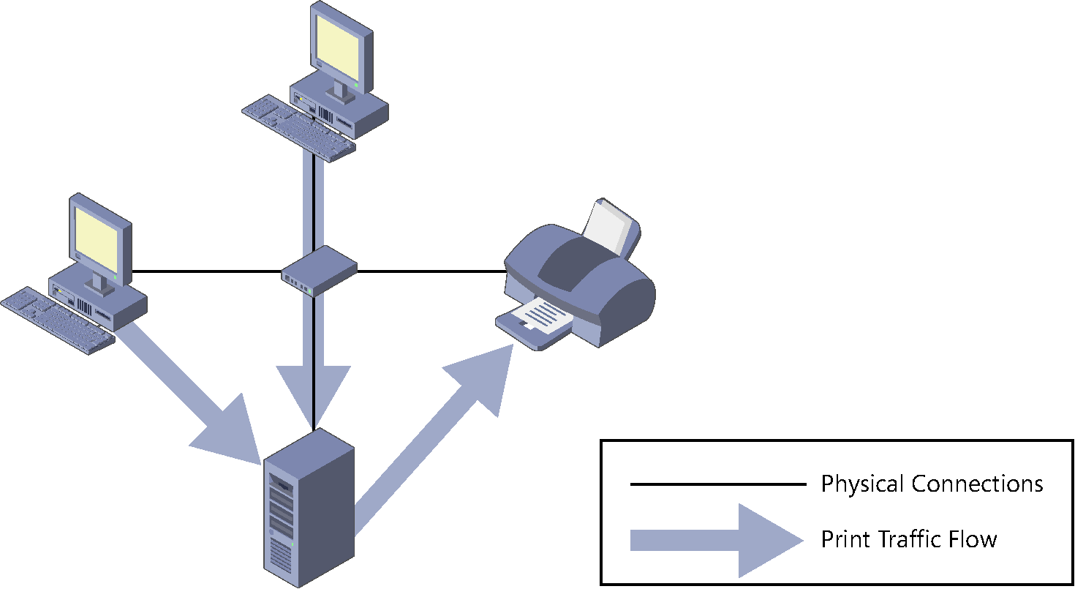
NETWORK-ATTACHED PRINTER SHARING (Contd.,)
Fig: A network-attached print device with a single shared print server

Slide 22
NETWORK-ATTACHED PRINTER SHARING (Contd.,)
With this arrangement, virtually all the disadvantages of the multiple print server arrangement become advantages:
All the client jobs are stored in a single print queue, so users and administrators can see a complete list of the jobs waiting to be printed.
Part of the job-rendering burden is shifted to the print server, returning control of the client computer to the user more quickly.

Slide 23
NETWORK-ATTACHED PRINTER SHARING (Contd.,)
Administrators can manage all the queued jobs from a remote location.
Print error messages appear on all client computers.
Administrators can implement printer pools and other advanced printing features.
Administrators can manage security, auditing, monitoring, and logging functions from a central location.

Slide 24
ADVANCED PRINTING CONFIGURATIONS
Administrators can use the four configurations described in the previous sections as building blocks to create printing solutions for their networks.
Many possible variations can be used to create a network printing architecture that supports your organization’s needs.
Some of the more advanced possibilities are as follows:

Slide 25
ADVANCED PRINTING CONFIGURATIONS (Contd.,)
You can connect a single printer to multiple print devices, creating what is called a printer pool. On a busy network with many print clients, the print server can distribute large numbers of incoming jobs among several identical print devices to provide more timely service and better fault tolerance.
You can connect multiple print devices that support different paper forms and various paper sizes to a single printer, which will distribute jobs with different requirements to the appropriate print devices.

Slide 26
ADVANCED PRINTING CONFIGURATIONS (Contd.,)
You can connect multiple printers to a single print device. By creating multiple printers, you can configure different priorities, security settings, auditing, and monitoring parameters for different users.
For example, you can create a high-priority printer for company executives and a lower-priority printer for junior users. This ensures that the executives’ jobs get printed first, even if the printers are connected to the same print device.

Slide 27
Sharing a Printer
Managing Printer Drivers
Using Remote Access Easy Print
Configuring Printer Security

Slide 28
Sharing a Printer
Using Windows Server 2012 R2 as a print server can be simple or complex, depending on how many clients the server has to support and how much printing they do.
For a home or small business network, in which a handful of users need occasional access to the printer, no special preparation is necessary.
However, if the computer must support heavy printer use, hardware upgrades (such as additional disk space or system memory) might be needed.

Slide 29
Sharing a Printer (Contd.,)
For network-attached print devices, an installation program supplied with the product locates the print device on the network, installs the correct drivers, creates a printer on the computer, and configures the printer with the proper IP address and other settings.
After the printer is installed on the Windows Server 2012 R2 computer that will function as your print server, you can share it with your network clients by using the following procedure.
Notes:
PROPERTIES
The shortcut menu for every printer provides access to two Properties sheets. The Printer
Properties menu item opens the Properties sheet for the printer and the Properties menu
item opens the Properties sheet for the print device.

Slide 30
Sharing a Printer (Contd.,)
1. Open the Devices and Printers control panel. The Devices and Printers window appears.
2. Right-click the icon for the printer you want to share and, from the shortcut menu, select Printer Properties. The printer’s Properties sheet appears.
3. Click the Sharing tab.
4. Select the Share This Printer check box. The printer name appears in the Share Name
text box. You can accept the default name or supply one of your own.

Slide 31
Sharing a Printer (Contd.,)
5. Select one or both of the following optional check boxes:
■■ Render Print Jobs On Client Computers Minimizes the resource utilization on the print server by forcing the print clients to perform the bulk of the print processing.
■■ List In The Directory Creates a new printer object in the Active Directory Domain Services (AD DS) database, enabling domain users to locate the printer by searching the directory. This option appears only when the computer is a member of an AD DS domain.
6. Optionally, click Additional Drivers to open the Additional Drivers dialog box.

Slide 32
Sharing a Printer (Contd.,)
7. Select any combination of the available check boxes and click OK. For each check box you select, Windows Server 2012 R2 displays a Printer Drivers dialog box.
8. In each Printer Drivers dialog box, type or browse to the location of the printer drivers for the selected operating system and click OK.
9. Click OK to close the Additional Drivers dialog box.
10. Click OK to close the Properties sheet for the printer. The printer icon in the Printers control panel now includes a symbol indicating that it has been shared.
11. Close the control panel.
At this point, the printer is available to clients on the network.

Slide 33
Managing printer drivers
Printer drivers are the components that enable your computers to manage the capabilities of your print devices.
When you install a printer on a server running Windows Server 2012 R2, you also install a driver that other Windows computers can use.
As a 64-bit platform, Windows Server 2012 R2 uses 64-bit device drivers, which are suitable for other computers running 64-bit versions of Windows.
If you have 32-bit Windows systems on your network, however, you must install a 32-bit driver on the server for those systems to use.

Slide 34
Managing printer drivers (Contd.,)
The Additional Drivers dialog box, accessible from the Sharing tab of a printer’s Properties sheet, enables you to install drivers for other processor platforms.
However, you must install those drivers from a computer running on the alternative platform. In other words, to install a 32-bit driver for a printer on a server running Windows Server 2012 R2, you must access the printer’s Properties sheet from a computer running a 32-bit version of Windows.
You can do this by accessing the printer directly through the network by using File Explorer or by running the Print Management snap-in on the 32-bit system and using it to manage your Windows Server 2012 R2 print server.
Notes:
INSTALLING DRIVERS
For the server to provide drivers supporting different platforms to client computers, you
must make sure when installing the drivers for the same print device that they have identical
names. For example, Windows Server 2012 R2 will treat “HP LaserJet 5200 PCL6” and
“HP LaserJet 5200 PCL 6” as two different drivers. The names must be identical in order for
the server to apply the drivers properly.

Slide 35
Using remote access Easy Print
When a Remote Desktop Services client connects to a server, it runs applications using the server’s processor(s) and memory.
However, if that client wants to print a document from one of those applications, it wants the print job to go to the print device connected to the client computer.
The component that enables Remote Desktop clients to print to their local print devices is called Easy Print.
Easy Print takes the form of a printer driver that is installed on the server along with the Remote Desktop Session Host role service.

Slide 36
Using remote access Easy Print (Contd.,)
On Windows Server 2012 R2, Easy Print requires no configuration other than the allowance of Remote Desktop connections or the installation of the Remote Desktop Services role.
When a Remote Desktop client connects to a server by using the Remote Desktop Connection program or the RD Web Access site, the printers installed on the client system are redirected to the server and appear in the Print Management snap-in as redirected server printers, as shown in Figure.

Slide 37
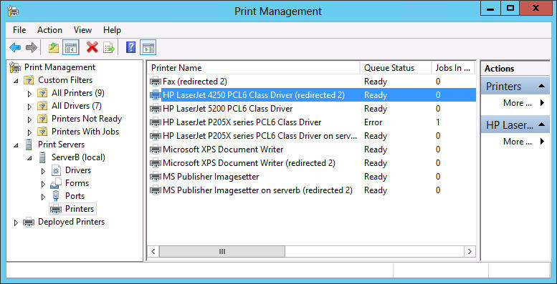
Using remote access Easy Print (Contd.,)
Fig: Printers redirected by Easy Print on a Remote Desktop server

Slide 38
Configuring printer security
Printer permissions are much simpler than NTFS permissions; they dictate whether users are allowed to use the printer, manage documents submitted to the printer, or manage the properties of the printer itself.
To assign permissions for a printer, use the following procedure.
1. Open Control Panel and select Hardware, Devices and Printers. The Devices and Printers window appears.

Slide 39
Configuring printer security (Contd.,)
2. Right-click one of the printer icons in the window and, from the shortcut menu, select Printer Properties. The printer’s Properties sheet appears.
3. Click the Security tab. The top half of the display lists all the security principals currently possessing permissions to the selected printer. The bottom half lists the permissions held by the selected security principal.
4. Click Add. The Select Users, Computers, Or Groups dialog box appears.

Slide 40
Configuring printer security (Contd.,)
5. In the Enter The Object Names To Select text box, type a user or group name and click OK. The user or group appears in the Group Or User Names list.
6. Select the security principal you added and select or clear the check boxes in the bottom half of the display to Allow or Deny the user any of the basic permissions.
7. Click OK to close the Properties sheet.
8. Close Control Panel.
Like NTFS permissions, there are two types of printer permissions: basic and advanced.
Each of the basic permissions consists of a combination of advanced permissions.

Slide 41
Managing Documents & Printer
Setting Printer Priorities
Creating a Printer Pool

Slide 42
Managing documents
By default, all printers assign the Allow Print permission to the Everyone special identity, which enables all users to access the printer and manage their own documents.
Users who possess the Allow Manage Documents permission can manage any users’ documents.
Managing documents refers to pausing, resuming, restarting, and canceling documents that are currently waiting in a print queue.
Windows Server 2012 R2 provides a print queue window for every printer, which enables users to view the jobs that are currently waiting to be printed.

Slide 43
Managing documents (Contd.,)
To manage documents, use the following procedure.
1. Open Control Panel and select Hardware, Devices and Printers. The Devices and Printers window appears.
2. Right-click one of the printer icons and, from the shortcut menu, select See What’s Printing. A print queue window named for the printer appears, as shown in Figure.

Slide 44
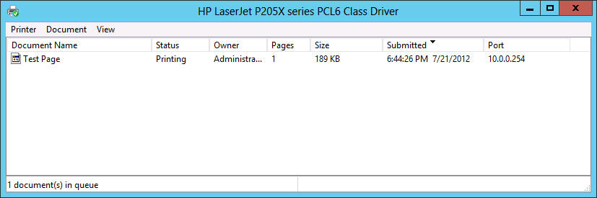
Managing documents (Contd.,)
3. Select one of the menu items to perform the associated function.
4. Close the print queue window.
5. Close Control Panel.
Fig: A Windows Server 2012 R2 print queue window

Slide 45
Managing printers
Users with the Allow Manage This Printer permission can go beyond manipulating queued documents; they can reconfigure the printer itself.
Managing a printer refers to altering the operational parameters that affect all users and controlling access to the printer.
Day-to-day printer management is more likely to involve physical maintenance, such as clearing print jams, reloading paper, and changing toner or ink cartridges.
However, the following sections examine some of the printer manager’s typical configuration tasks.

Slide 46
Setting printer priorities
In some cases, administrators with the Manage This Printer permission might want to give certain users in their organization the priority access to a print device so that when print traffic is heavy, their jobs are processed before those of other users.
To do this, you must create multiple printers, associate them with the same print device, and then modify their priorities, as described in the following procedure.
1. Open Control Panel and select Hardware, Devices and Printers. The Devices and Printers window opens.
Notes:
PRINTER PRIORITIES
The values of the Priority spin box do not have any absolute significance; they are pertinent
only in relation to one another. As long as one printer has a higher priority value than
another, the server will process its print jobs first. In other words, it doesn’t matter if the
higher priority value is 9 or 99, as long as the lower priority value is less.

Slide 47
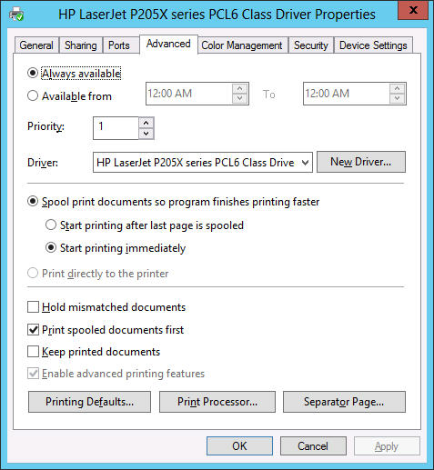
Setting printer priorities (Contd.,)
2. Right-click one of the printer icons and, from the shortcut menu, select Printer Properties. The Properties sheet for the printer appears.
3. Click the Advanced tab, as shown in Figure.
Fig: The Advanced tab of a printer’s Properties sheet

Slide 48
Setting printer priorities (Contd.,)
4. Set the Priority spin box to a number representing the highest priority you want to set for the printer. Higher numbers represent higher priorities. The highest possible priority is 99.
5. Click the Security tab.
6. Add the users or groups that you want to provide with high-priority access to the printer and assign the Allow Print permission to them.
7. Revoke the Allow Print permission from the Everyone special identity.
8. Click OK to close the Properties sheet.

Slide 49
Setting printer priorities (Contd.,)
9. Create an identical printer using the same printer driver and pointing to the same print device. Leave the Priority setting at its default value of 1 and leave the default permissions in place.
10. Rename the printers, specifying the priority assigned to each one.
11. Close Control Panel.
Inform the privileged users that they should send their jobs to the high-priority printer.
All jobs sent to that printer will be processed before those sent to the other, lower-priority printer.

Slide 50
Creating a printer pool
As mentioned earlier, a printer pool increases the production capability of a single printer by connecting it to multiple print devices.
When you create a printer pool, the print server sends each incoming job to the first print device it finds that is not busy.
This effectively distributes the jobs among the available print devices, providing users with more rapid service.

Slide 51
Creating a printer pool (Contd.,)
To configure a printer pool, use the following procedure.
1. Open Control Panel and select Hardware, Devices and Printers. The Devices and Printers window opens.
2. Right-click one of the printer icons and, from the shortcut menu, select Printer Properties. The Properties sheet for the printer appears.
3. Click the Ports tab.
4. Select the Enable Printer Pooling check box and click OK.
5. Select all the ports to which the print devices are connected.
6. Close Control Panel.
Notes:
To create a printer pool, you must have at least two identical print devices, or at least two
print devices that use the same printer driver. The print devices must be in the same location
because there is no way to tell which print device will process a given documents.

Slide 52
Using the Print and Document Services Role
Adding Printer Servers
Viewing Printers
Managing printers and print servers
Deploying Printers with Group Policy

Slide 53
Using the Print and Document Services role
All the printer sharing and management capabilities discussed in the previous sections are available on any Windows Server 2012 R2 computer in its default installation configuration.
However, installing the Print And Document Services role on the computer provides additional tools that are particularly useful to administrators involved with network printing on an enterprise scale.

Slide 54
Using the Print and Document Services role (Contd.,)
When you install the Print And Document Services role by using Server Manager’s Add Roles And Features Wizard, a Select Role Services page appears, enabling you to select from the following options:
Print Server Installs the Print Management console for Microsoft Management Console (MMC), which enables administrators to deploy, monitor, and manage printers throughout the enterprise
Distributed Scan Server Enables the computer to receive documents from network-based scanners and forward them to the appropriate users
Internet Printing Creates a website that enables users on the Internet to send print jobs to shared Windows printers
LPD Service Enables UNIX clients running the line printer remote (LPR) program to send their print jobs to Windows printers

Slide 55
Using the Print and Document Services role (Contd.,)
The Print Management console, an administrative tool, consolidates the controls for the printing components throughout the enterprise into a single console.
By using this tool, you can access the print queues and Properties sheets for all the network printers in the enterprise, deploy printers to client computers by using Group Policy.

Slide 56
Using the Print and Document Services role (Contd.,)
Windows Server 2012 R2 installs the Print Management console when you add the Print And Document Services role to the computer.
You can also install the console without the role by adding the Print And Document Services Tools feature, found under Remote Server Administration Tools, Role Administration Tools in the Add Roles And Features Wizard.

Slide 57
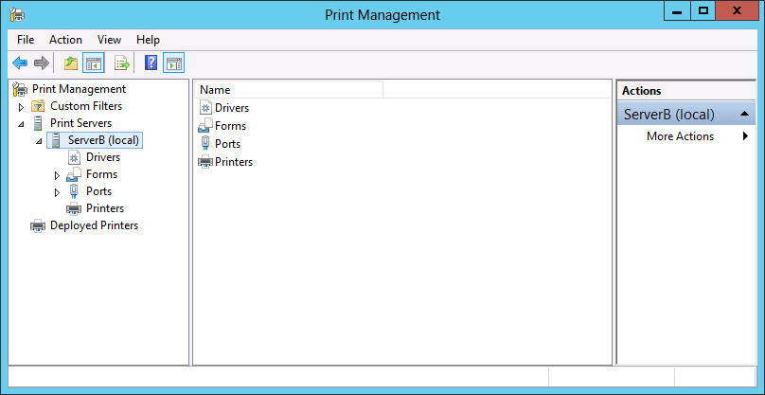
Adding print servers
By default, the Print Management console displays only the local machine in its list of print servers.
Each print server has four nodes beneath it, as shown in Figure, listing the drivers, forms, ports, and printers associated with that server.
Fig: A print server displayed in the Print Management console

Slide 58
Adding print servers (Contd.,)
To manage other print servers and their printers, you must add them to the console by using the following procedure.
1. In Server Manager, click Tools and then click Print Management to open the Print Management console.
2. Right-click the Print Servers node and, from the shortcut menu, click Add/Remove Servers to open the Add/Remove Servers dialog box.
3. In the Specify Print Server box, click Browse. The Select Print Server dialog box opens.

Slide 59
Adding print servers (Contd.,)
4. Select the print server you want to add to the console and click Select Server. The server you selected appears in the Add Server text box in the Add/Remove Servers dialog box.
5. Click Add To List. The server you selected appears in the Print Servers list.
6. Click OK. The server appears under the Print Servers node.
7. Close the Print Management console.
You can now manage the printers associated with the server you have added to the console.

Slide 60
Viewing printers
One of the major difficulties for printing administrators on large enterprise networks is keeping track of dozens or hundreds of print devices, all in frequent use and all needing attention on a regular basis.
Whether the maintenance required is a major repair, an ink or toner replenishment, or a paper tray refill, print devices will not get the attention they need until an administrator is aware of the problem.

Slide 61
Viewing printers (Contd.,)
The Print Management console provides multiple ways to view the printing components associated with the print servers on the network.
To create views, the console takes the complete list of printers and applies various filters to it, selecting which printers to display.

Slide 62
Viewing printers (Contd.,)
Under the Custom Filters node, there are four default filters, as follows:
All Printers Contains a list of all the printers hosted by all the print servers which have been added to the console
All Drivers Contains a list of all the printer drivers installed on all the print servers which have been added to the console
Printers Not Ready Contains a list of all printers that are not reporting a Ready status
Printers With Jobs Contains a list of all the printers that currently have jobs waiting in the print queue
Views such as Printer Not Ready are a useful way for administrators to identify printers that need attention.

Slide 63
Managing printers and print servers
After you have used filtered views to isolate the printers you want to examine, selecting a printer displays its status, the number of jobs currently in its print queue, and the name of the print server hosting it.
If you right-click the filter in the left pane and select Show Extended View from the shortcut menu, an additional pane appears containing the contents of the selected printer’s queue.
The Print Management console also enables administrators to access the configuration interface for any printer or print server appearing in any of its displays.

Slide 64
Managing printers and print servers (Contd.,)
Right-clicking a printer or print server anywhere in the console interface and then selecting Properties from the shortcut menu displays the same Properties sheet you would see on the print server computer itself.
Administrators can then configure printers and print servers without having to travel to the site of the print server or establish a Remote Desktop connection to the print server.

Slide 65
Deploying printers with Group Policy
Configuring a print client to access a shared printer is a simple matter of browsing the network or the AD DS tree and selecting the printer.
However, when you have to configure hundreds or thousands of print clients, the task becomes more complicated.
AD DS helps simplify the process of deploying printers to large numbers of clients.
Publishing printers in the AD DS database enables users and administrators to search for printers by name, location, or model.

Slide 66
Deploying printers with Group Policy (Contd.,)
To create a printer object in the AD DS database, you can either select the List In The Directory check box while sharing the printer or right-click a printer in the Print Management console and, from the shortcut menu, select List In Directory.
To use AD DS to deploy printers to clients, you must configure the appropriate policies in a Group Policy object (GPO).
When you configure a GPO to deploy a printer, all the users or computers in that domain, site, or OU will receive the printer connection by default when they log on.
To deploy printers with Group Policy, use the following procedure.

Slide 67
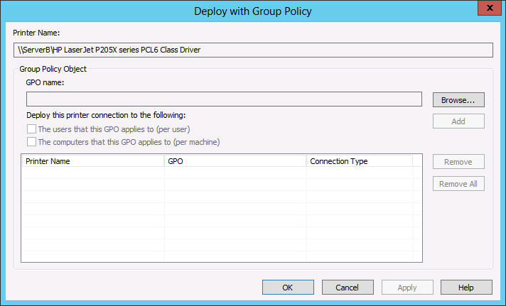
Deploying printers with Group Policy (Contd.,)
1. In the Print Management console, right-click a printer in the console’s scope pane and, from the shortcut menu, select Deploy With Group Policy. The Deploy With Group Policy dialog box appears, as shown in Figure.
Fig: The Deploy With Group Policy dialog box

Slide 68
Deploying printers with Group Policy (Contd.,)
2. Click Browse to open the Browse For A Group Policy Object dialog box.
3. Select the GPO you want to use to deploy the printer and click OK. The GPO you selected appears in the GPO Name field.
4. Select the appropriate check box to select whether to deploy the printer to the users associated with the GPO, the computers (or both) and click Add. The new printer GPO associations appear in the table.
Notes:
Deploying the printer to the users means that all the users associated with the GPO will
receive the printer connection no matter what computer they use to log on. Deploying
the printer to the computers means that all the computers associated with the GPO will
receive the printer connection no matter who logs on to them.

Slide 69
Deploying printers with Group Policy (Contd.,)
5. Click OK. A Print Management message box appears, informing you that the operation has succeeded.
6. Click OK and then click OK again to close the Deploy With Group Policy dialog box.
7. Close the Print Management console.
The next time the users running Windows Server 2008 or later and Windows Vista or later who are associated with the GPO refresh their policies or restart, they will receive the new settings and the printer will appear in the Devices and Printers control panel.

Slide 70
Configuring Servers for Remote Management
Using Server Manager for Remote Management
Adding servers
Managing non-domain joined servers
Managing Windows Server 2012 R2 servers
CONFIGURING WINRM
CONFIGURING WINDOWS FIREWALL
Managing down-level servers
Creating server groups
Using Remote Server Administration Tools
Working with remote servers

Slide 71
Configure servers for remote management
Windows Server 2012 R2 is designed to facilitate remote server management so administrators rarely, if ever, have to work directly at the server console. This conserves server resources that can better be devoted to applications and saves administrators’ time.

Slide 72
Using Server Manager for remote management
Server Manager has been the primary server administration tool for Windows Server ever since Windows Server 2003.
The most obvious improvement to the Server Manager tool in Windows Server 2012 R2 is the ability to perform administrative tasks on remote servers and on the local system.
The Server Manager interface consists of a navigation pane on the left containing icons representing various views of server resources.

Slide 73
Using Server Manager for remote management (Contd.,)
Selecting an icon displays a home page in the right pane, which consists of a number of tiles containing information about the resource.
The Dashboard page, which appears by default, contains, in addition to the Welcome tile, thumbnails that summarize the other views available in Server Manager.
These other views include a page for the Local Server, a page for All Servers, containing any additional servers you have added to the manager, and others for server groups and role groups.

Slide 74
Adding servers
The primary difference between the Windows Server 2012 R2 (and Windows Server 2012) Server Manager and previous versions is the ability to add and manage multiple servers at once.
The servers you add can be physical or virtual and can be running any version of Windows Server since Windows Server 2003.
After you add servers to the interface, you can create groups containing collections of servers, such as those at a particular location or those performing a particular function.
These groups appear in the navigation pane, enabling you to administer them as a single entity.

Slide 75
Adding servers (Contd.,)
To add servers in Server Manager, use the following procedure.
1. In the navigation pane, click the All Servers icon to open the All Servers home page.
2. From the Manage menu, select Add Servers to open the Add Servers dialog box.
3. Select one of the following tabs to specify how you want to locate servers to add:
Active Directory Enables you to search for computers running specific operating systems in specific locations in the local AD DS domain
DNS Enables you to search for servers in your currently configured Domain Name System (DNS) server
Import Enables you to supply a text file containing the names or IP addresses of the servers you want to add

Slide 76
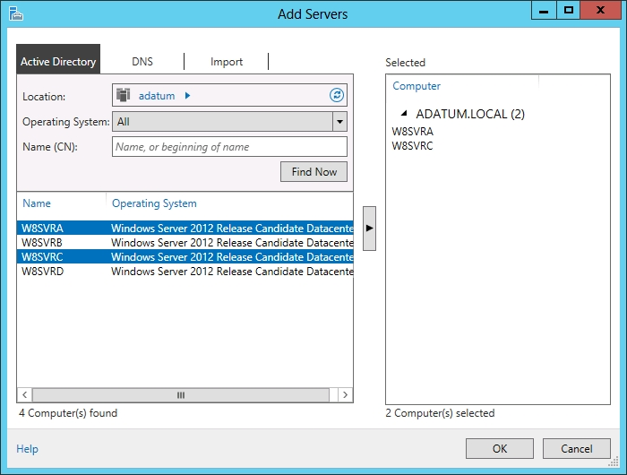
Adding servers (Contd.,)
4. Initiate a search or upload a text file to display a list of available servers.
5. Select the servers you want to add and click the right arrow button to add them to the Selected list, as shown in Figure.
6. Click OK. The servers you selected are added to the All Servers home page.
7. Close the Server Manger console.
Fig: Selecting servers in Server Manager

Slide 77
Managing non-domain joined servers
When you add servers that are members of an Active Directory Domain Services (AD DS) domain to the Server Manager interface, Windows Server 2012 R2 uses the standard Kerberos authentication protocol and your current domain credentials when connecting to the remote systems.
You can also add servers that are not joined to an AD DS domain, but obviously, the system cannot authenticate using an AD DS account.

Slide 78
Managing non-domain joined servers (Contd.,)
To manage a non-domain joined server using Server Manager, you must first complete the following tasks:
Supply administrative credentials for the non-domain joined server
Add the non-domain joined server to the system’s WS-Management TrustedHosts list
To add non-domain joined servers to Server Manager, you must use the DNS option or the Import option in the Add Servers Wizard.
After creating the server entries, you must right-click each one and select Manage As from the context menu.
This displays a Windows Security dialog box, in which you can supply credentials for an account with administrative privileges on the remote server.

Slide 79
Managing non-domain joined servers (Contd.,)
To manage computers that are not in a common domain, you must establish that trust yourself by adding the computers you want to manage to the TrustedHosts list on the computer running Server Manager.
The TrustedHosts list exists on a logical drive called WSMan:; the path to the list itself is WSMan:\localhost\Client\TrustedHosts.
To add a computer to the list, use the Set-Item cmdlet in Windows PowerShell.
After opening a Windows PowerShell session with administrative privileges on the computer running Server Manager, use the following command to add the servers you want to manage to the list:
Set-Item WSMan:\localhost\Client\TrustedHosts –value <servername> -force

Slide 80
Managing Windows Server 2012 R2 servers
When you add servers running Windows Server 2012 R2 to Server Manager, you can immediately begin using the Add Roles and Features Wizard to install roles and features on any of the servers you have added.
You can also perform other administrative tasks, such as configuring network interface card (NIC) teaming and restarting the server, because Windows Remote Management (WinRM) is enabled by default on Windows Server 2012 R2.

Slide 81
CONFIGURING WINRM
WinRM enables administrators to manage a computer from a remote location by using tools based on Windows Management Instrumentation (WMI) and Windows PowerShell.
If the default WinRM setting has been modified, or if you want to change it manually, you can do through the Server Manager interface.
On the Local Server home page, the Properties tile contains a Remote Management indicator that specifies the server’s current WinRM status.
To change the WinRM state, click the Remote Management hyperlink to open the Configure Remote Management dialog box.
Clearing the Enable Remote Management Of This Server From Other Computers check box disables WinRM; selecting the check box enables it.

Slide 82
CONFIGURING WINRM (Contd.,)
USING WINDOWS POWERSHELL
To manage WinRM from a Windows PowerShell session, as in the case of a computer with a Server Core installation, use the following command:
Configure-SMRemoting.exe –Get|–Enable|-Disable
-Get Displays the current WinRM status
-Enable Enables WinRM
-Disable Disables WinRM

Slide 83
CONFIGURING WINDOWS FIREWALL
If you attempt to launch MMC snap-ins targeting a remote server, such as the Computer Management console, you will receive an error because of the default Windows Firewall settings in Windows Server 2012 R2. MMC uses the Distributed Component Object Model (DCOM) for remote management instead of WinRM, and these settings are not enabled by default.
To address this problem, you must enable the following inbound Windows Firewall rules on the remote server you want to manage:
COM+ Network Access (DCOM-In)
Remote Event Log Management (NP-In)
Remote Event Log Management (RPC)
Remote Event Log Management (RPC-EPMAP)
Notes:
RPC-EPMAP Remote Procedure Call-End point mapper
DCOM Distributed Component Object Model

Slide 84
CONFIGURING WINDOWS FIREWALL (Contd.,)
To modify the firewall rules on the remote system, you can use any one of the following methods:
Open the Windows Firewall with Advanced Security MMC snap-in on the remote server (if it is a Full GUI installation).
Use the NetSecurity module in Windows PowerShell.
Create a GPO containing the appropriate settings and apply it to the remote server.
Run the Netsh AdvFirewall command from an administrative command prompt.
USING WINDOWS POWERSHELL
To configure the Windows Firewall rules required for remote server management using DCOM on a Server Core installation, you can use the following Windows PowerShell syntax:
Set-NetFirewallRule –name <rule name> –enabled True

Slide 85
CONFIGURING WINDOWS FIREWALL (Contd.,)
To configure Windows Firewall settings by using Group Policy, use the following procedure.
This procedure assumes the server is a member of an AD DS domain and has the Group Policy Management feature installed:
1. In Server Manager, open the Group Policy Management console and create a new GPO, giving it a name like Server Firewall Configuration.
2. Open the GPO you created using the Group Policy Management Editor.

Slide 86
CONFIGURING WINDOWS FIREWALL (Contd.,)
3. Browse to the Computer Configuration\Policies\Windows Settings\Security Settings \Windows Firewall with Advanced Security\Inbound Rules node.
4. Right-click Inbound Rules and, from the shortcut menu, select New Rule. The New Inbound Rule Wizard appears, displaying the Rule Type page.
5. Select the Predefined option and, in the drop-down list, select COM+ Network Access and click Next. The Predefined Rules page opens.
6. Click Next to open the Action page.
7. Leave the Allow The Connection option selected and click Finish. The rule appears in the Group Policy Management Editor console.

Slide 87
CONFIGURING WINDOWS FIREWALL (Contd.,)
8. Open the New Inbound Rule Wizard again.
9. Select the Predefined option and, in the drop-down list, select Remote Event Log Management. Click Next. The Predefined Rules page opens, displaying the three rules in the Remote Event Log Management group.
10. Leave the three rules selected and click Next to open the Action page.
11. Leave the Allow The Connection option selected and click Finish. The three rules appear in the Group Policy Management Editor console.

Slide 88
CONFIGURING WINDOWS FIREWALL (Contd.,)
12. Close the Group Policy Management Editor console.
13. In the Group Policy Management console, link the Server Firewall Configuration GPO you just created to your domain.
14. Close the Group Policy Management console.
The settings in the GPO you created will be deployed to your remote servers the next time they recycle or restart and you will be able to use MMC snap-ins, such as Computer Management and Disk Management, to connect to them remotely.

Slide 89
Managing down-level servers
The Windows Firewall rules you have to enable for remote servers running Windows Server 2012 R2 are also disabled by default on computers running earlier versions of Windows Server, so you also have to enable them there.
Unlike Windows Server 2012 R2 and Windows Server 2012, however, earlier versions of the operating system lack the WinRM support needed for them to be managed by using the new Server Manager.

Slide 90
Managing down-level servers (Contd.,)
To add WinRM support to servers running Windows Server 2008 or Windows Server 2008 R2, you must download and install the following updates:
.NET Framework 4.0
Windows Management Framework 3.0
These updates are available from the Microsoft Download Center at the following URLs:
http://www.microsoft.com/en-us/download/details.aspx?id=17718
http://www.microsoft.com/en-us/download/details.aspx?id=34595
After you install the updates, the system automatically starts the Windows Remote Management service, but you must still complete the following tasks on the remote server:
Enable the Windows Remote Management (HTTP-In) rules in Windows Firewall, as shown in Figure.
Create a WinRM listener by running the winrm quickconfig command at a command prompt with Administrative privileges.
Enable the COM+ Network Access and Remote Event Log Management rules in Windows Firewall, as described in the previous section.

Slide 91
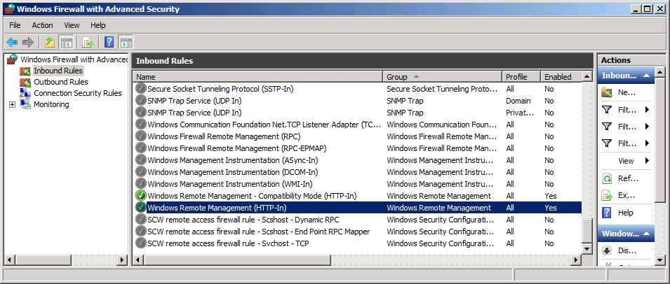
Managing down-level servers (Contd.,)
Fig: The Windows Remote Management rules in the Windows Firewall with Advanced Security console

Slide 92
Managing down-level servers (Contd.,)
You can use Windows PowerShell to install roles and features on servers running Windows Server 2008 and Windows Server 2008 R2 remotely, as in the following procedure.
1. Open a Windows PowerShell session with Administrative privileges.
2. Establish a Windows PowerShell session with the remote computer by using the following command:
Enter-PSSession <remote server name> -credential <user name>
3. Type the password associated with the user name you specified and press Enter.

Slide 93
Managing down-level servers (Contd.,)
4. Display a list of the roles and features on the remote server by using the following command:
Get-WindowsFeature
5. Using the short name of the role or service as it appears in the Get-WindowsFeature display, install the component by using the following command:
Add-WindowsFeature <feature name>
6. Close the session with the remote server by using the following command:
Exit-PSSession
7. Close the Windows PowerShell window.

Slide 94
Creating server groups
For administrators of enterprise networks, it might be necessary to add a large number of servers to Server Manager.
To avoid having to work with a long scrolling list of servers, you can create server groups based on server locations, functions, or any other organizational paradigm.
When you create a server group, it appears as an icon in the navigation pane, and you can manage the servers in the group just as you would those in the All Servers group.

Slide 95
Creating server groups (Contd.,)
To create a server group, use the following procedure:
1. In Server Manager, in the navigation pane, click the All Servers icon. The All Servers home page appears.
2. From the Manage menu, select Create Server Group to open the Create Server Group dialog box, as shown in Figure.
3. In the Server Group Name text box, type the name you want to assign to the server group.
4. Select one of the four tabs to choose a method for selecting servers.

Slide 96
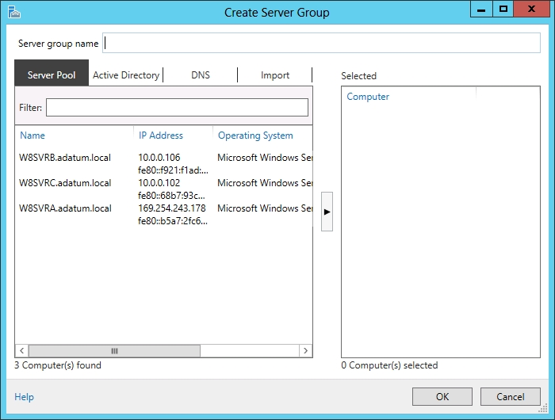
Creating server groups (Contd.,)
Fig: The Create Server Group dialog box in Server Manager

Slide 97
Creating server groups (Contd.,)
5. Select the servers you want to add to the group and click the right arrow button to add them to the Selected box.
6. Click OK. A new server group icon with the name you specified appears in the navigational pane.
7. Close the Server Manager console.
Creating server groups does not affect the functions you can perform on them. You cannot, for example, perform actions on entire groups of servers. The groupings are just a means to keep a large number of servers organized and easy to locate.

Slide 98
Using Remote Server Administration Tools
You can manage remote servers from any computer running Windows Server 2012 R2; all the required tools are installed by default.
However, administrators have found it most efficient to use their client computers to manage servers remotely (especially with the introduction of cloud-based services).
To manage Windows servers from a workstation, you must download and install the Remote Server Administration Tools package for the version of Windows running on your workstation from the Microsoft Download Center at http://www.microsoft.com/download.

Slide 99
Working with remote servers
Once you have added remote servers to Server Manager, you can access them using a variety of remote administration tools.
Server Manager provides three basic methods for addressing remote servers, as follows:
Contextual tasks When you right-click a server in a Servers tile anywhere in Server Manager, you see a shortcut menu that provides access to tools and commands pointed at the selected server. Some of these are commands that Server Manager executes on the remote server, such as Restart Server and Windows PowerShell.

Slide 100
Working with remote servers (Contd.,)
Noncontextual tasks The menu bar at the top of the Server Manager console provides access to internal tasks, such as launching the Add Server Wizard and the Install Roles And Features Wizard, and the Server Manager Properties dialog box, in which you can specify the console’s refresh interval.
Noncontextual tools The console’s Tools menu provides access to external programs, such as MMC snap-ins and the Windows PowerShell interface, that are directed at the local system.

Slide 101
Install and Use Windows PowerShell Web Access
Windows PowerShell® Web Access, first introduced in Windows Server® 2012, acts as a Windows PowerShell gateway, providing a web-based Windows PowerShell console that is targeted at a remote computer.
It enables IT Pros to run Windows PowerShell commands and scripts from a Windows PowerShell console in a web browser, with no Windows PowerShell, remote management software, or browser plug-in installation necessary on the client device.
All that is required to run the web-based Windows PowerShell console is a properly-configured Windows PowerShell Web Access gateway, and a client device browser that supports JavaScript® and accepts cookies.

Slide 102
Install and Use Windows PowerShell Web Access (Contd.,)
Examples of client devices include laptops, non-work personal computers, borrowed computers, tablet computers, web kiosks, computers that are not running a Windows-based operating system, and cell phone browsers.
IT Pros can perform critical management tasks on remote Windows-based servers from devices that have access to an Internet connection and a web browser.
Windows PowerShell Web Access setup and configuration is a three-step process:
Installing Windows PowerShell Web Access
Configuring the gateway
Configuring authorization rules that allow users access to the web-based Windows PowerShell console

Slide 103
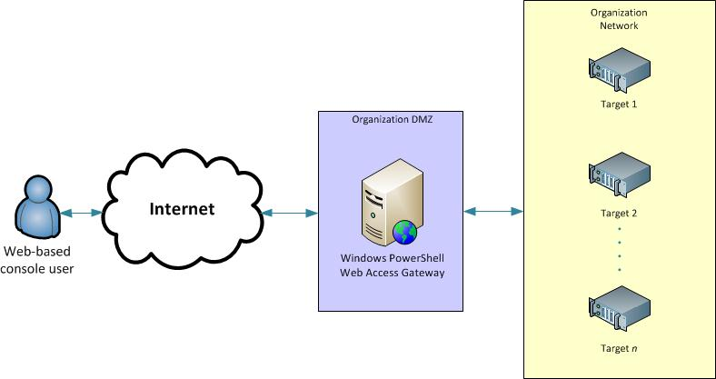
Install and Use Windows PowerShell Web Access (Contd.,)

Slide 104
Install PowerShellWebAccess
Enable WindowsPowerShell web access from Add roles and features by using Web Server (IIS) or WindowsPowerShell option.
Install UserCertificate for accessing PowershellWebAccess by using the PS cmd “install-PswaWebApplication –UserTestCertificate “ .
Use cmd to set rule to provide authorization for the users and Computer “Add-PswaAuthorizationRule –UserName * -ComputerName * -ConfigurationName * ”
From browser now user can able access the powershell.
Notes:
Run cmd- inetmgr to open IIS manager

Slide 105


